Slide 1
FIREFIGHTER DASHBOARD APPLICATION
CMPE 220 Project
Summer 2019

Slide 2




OUR TEAM
AAKASH
HALAK
PRASHANT
VATSAL
Manage audio recording and GUI QT based Dashboard for Raspberry Pi
Establish wireless connection and transmit data wirelessly
Interface heartbeat sensor with STM32 and push-to-talk service implementation
Interface GPS and air quality on STM32

Slide 3
AGENDA
HARDWARE USED
APPLICATION
Raspberry Pi 3 B+
STM32 MCU and STM LoRa
Sensors
Safety & Protection against hazard for Firefighter Team
IMPROVEMENT OVER EXISTING PRODUCT
INNOVATION
Fully embedded with sensors, a wearable device for firefighter team and a QT framework running dashboard application with Raspberry Pi 3 B+ as main controller for Firefighter Marshal.
Adding additional sensor for expanding into other applications like medical applications. Inbuilt push-to-talk service instead of additional walkie talkie

Slide 4
PRODUCT LAUNCH PROCESS
Manufacturing Concept
Research
Product Idea
Product Concept
Design
Prototyping
Production
Product
Currently, Firefighter are armed with walkie – talkie for communication. Communication with only walkie talkie might not be very effective.
To design such a product that provides more accurate location and surrounding information of fire crew conditions.
Developed for the safety of firefighter crew by providing their team lead with a dashboard through which he can monitor their location and health factors.
Dashboard controlled by Raspberry Pi 3 B+ and running on QT framework. STM32 used for crew members controlling and sending data of all sensors.
Wireless communication established between STM32 and Raspberry Pi 3 to communicate.
Low cost controller to reduce the cost of product.
Developed for Firefighters, the production will aim to Fire department.
Product developed will be tested with the help of Fire department to make it a better final product.

Slide 5

PRODUCT OVERVIEW
PRODUCT FEATURES
Location of crew member position using GPS.
Detection of level of gases around individual firefighter using air quality sensor.
Visual display controlled by Raspberry Pi for Lead Firefighter.
Easy Communication between firefighter over wireless protocol.
Push to talk feature embedded inside the controller, to give relevant instructions to crew.

Slide 6


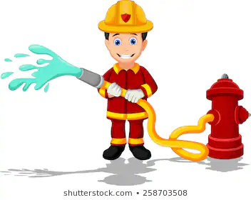

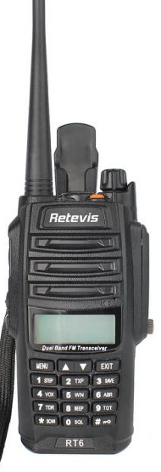
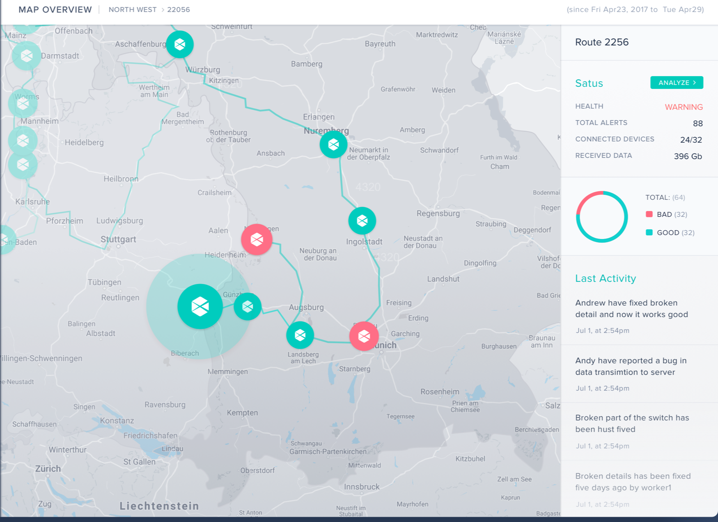
FOCUS AND VALUE PROPOSITION
PRODUCT
CUSTOMER
Low Cost
Raspberry Pi 3 B+
Monitor Health Status
Safety
Benefits
Wants
Visual Display
STM32 Lora
Easy to Use
Location Information
Firefighter safety
Hardware
Fears
Push to Talk
Push to Talk Service
Inaccurate Location
GPS sensor
Features
Needs
Accurate location
Air Quality Sensor
Visual Location of Team Members
Sensor Data
Wireless Connectivity
Walkie Talkie
Substitutes
Firefighter Dashboard
Firefighters Dashboard

Slide 7
INDUSTRY OVERVIEW
Current Scenario
After Using Product
On an average annually, around 100 firefighters lose their life on duty because of lack of embedded devices
If the team lead is able to monitor the position and communicate with them using push to talk service than more lives of firefighters can be saved.
Statistics Data of Current Product vs Proposed Product taking Safety as Parameter

Slide 8
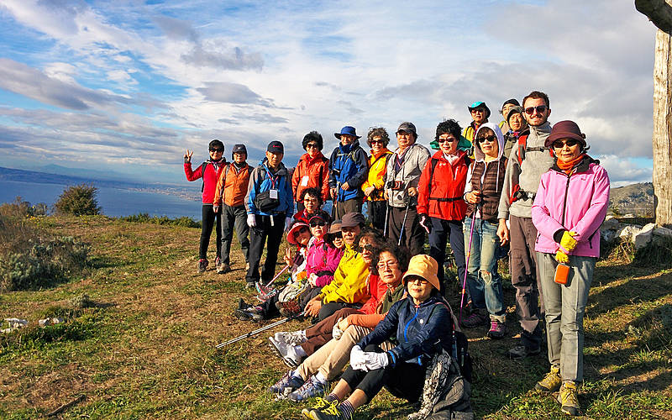
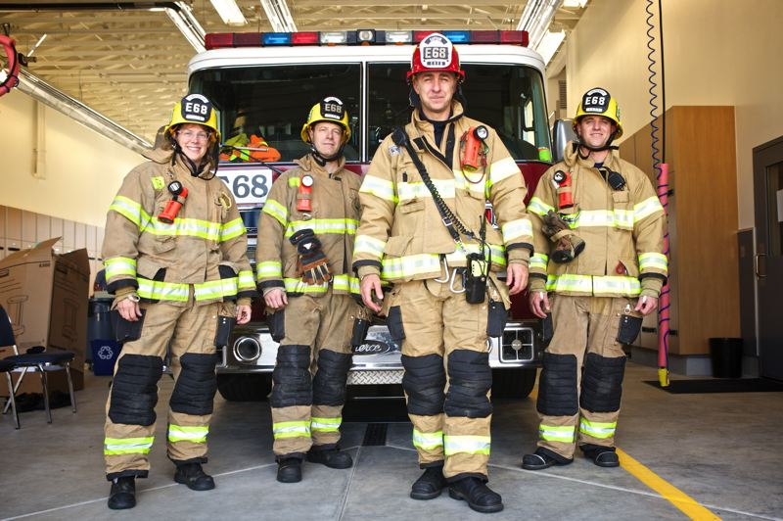

IDEAL CUSTOMER PROFILE
Fire Department
Hikers & Teams
As the product is originally developed for the safety of firefighters, it’s main customers aimed to be Firefighters..
With some modification in the device, by adding other sensors, this device can be used to monitor the location of team members during adventurous activities

Slide 9
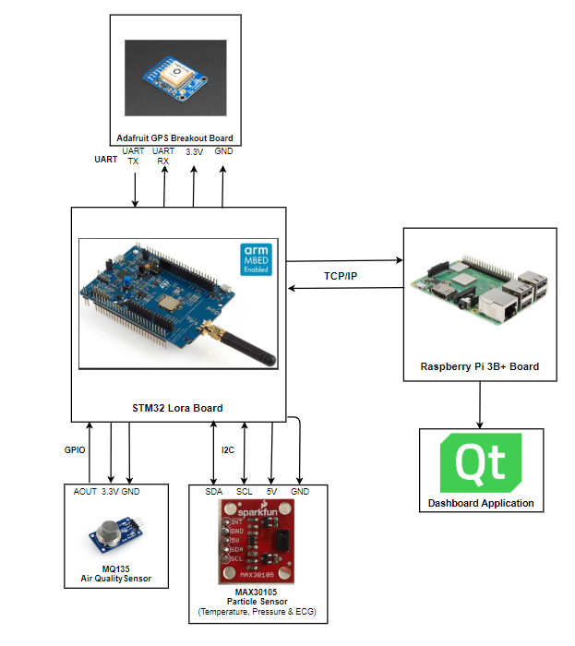
PRODUCT PROTOTYPE & SYSTEM BLOCK DIAGRAM
Our product shall consist of the air quality sensor to measure the gas concentration around the firefighter, where STM32 controller shall take the concentration value and warn about the hazards to the firefighter marshal, if the data exceeds certain limits.
Temperature and ECG values are obtained from particle sensor to measure temperature around firefighter and heartbeat of the firefighter.
The controller shall notify the firefighter marshal about the temperature exceeding above the dangerous limits.
These data will be monitored by the marshal with the help of QT application, which gets the data over a network. The push-to-talk service shall be implemented directly using a microphone and a speaker.

Slide 10


THANK YOU
DETAILS AVAILABLE AT:
https://drive.google.com/drive/u/1/folders/0ALOTuxiOtuoxUk9PVA

